Slide 1
Basic Hibernate Framework
Course
Java programming
Trainer
Designed by
To Chau
Last updated
Jul 25, 2011

Slide 2
Objectives
This seminar will provide you a solid understanding of what is Hibernate framework and how we can use it in project.

Slide 3
Contents
What is ORM?
How to save data into Database?
What is Hibernate framework?
Why we use Hibernate?
Hibernate architecture.
How to use Hibernate in project?
Example
Hibernate tools
References
Q&A

Slide 4
What is ORM
Object-relational mapping (ORM) is a mechanism that makes it possible to address, access and manipulate objects without having to consider how those objects relate to their data sources.

Slide 5
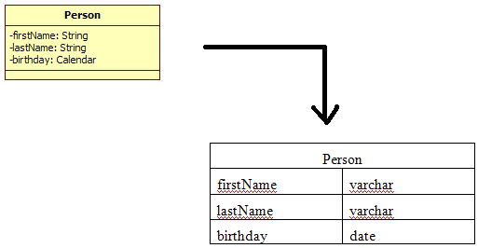

Slide 6
How to save data into database?
What you can imagine that you have your application with some functions (business logic) and you want to save data into a database?
Without Hibernate: the application code usually calls the connection pool to obtain JDBC connections and execute SQL statements.
Problem: when you use Java all the business logic normally works with objects of different class types. Your database tables are not at all objects.

Slide 7
What is Hibernate?
Hibernate is a powerful, high performance object/relational persistence and query service.
Hibernate provides a solution to map database tables to classes using XML configuration.
Act as a client of the JDBC connection pool. The application code uses classes, the Hibernate Session and Query APIs for persistence operations.
The main feature of Hibernate: simplify the job of accessing a database.

Slide 8
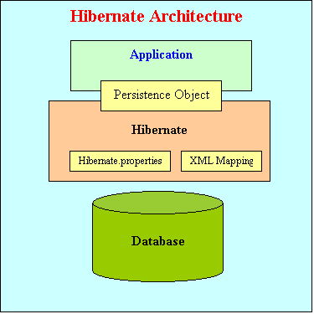
Hibernate Architecture

Slide 9
How to use Hibernate?
Create Java classes that represent the tables in the database
Write Hibernate Mapping files to map the instance variables in the class with the columns of table (*.hbm.xml).
Create Hibernate configuration file: hibernate.cfg.xml or hibernate.properties.
Use Hibernate API in business logic layer for database operations.

Slide 10
How to use Hibernate: Example
Data table: CONTACT
Person
ID
FIRSTNAME
LASTNAME
EMAIL

Slide 11
How to use Hibernate: Example
Persistence Class : Person
package roseindia.tutorial.hibernate; public class Contact { private String firstName; private String lastName; private String email; private long id; public String getFirstName() { return firstName; } public void setFirstName(String string) { firstName = string; } public String getLastName() { return lastName; } public void setLastName(String string) { lastName = string; } … }

Slide 12
How to use Hibernate: Example
Hibernate Mapping file: person.hbm.xml

Slide 13
<?xml version="1.0"?> <!DOCTYPE hibernate-mapping PUBLIC "-//Hibernate/Hibernate Mapping DTD 3.0//EN" "http://hibernate.sourceforge.net/hibernate-mapping-3.0.dtd"> <hibernate-mapping> <class name=“Person" table=“PERSON"> <id name="id" type="long" column="ID" > <generator class=“increment"/> </id> <property name="firstName"> <column name="FIRSTNAME" /> </property> <property name="lastName"> <column name="LASTNAME"/> </property> <property name="email"> <column name="EMAIL"/> </property> </class> </hibernate-mapping>

Slide 14
How to use Hibernate: Example
Hibernate configuration file: hibernate.cfg.xml

Slide 15
<?xml version='1.0' encoding='utf-8'?> <!DOCTYPE hibernate-configuration PUBLIC -//Hibernate/Hibernate Configuration DTD//EN" "http://hibernate.sourceforge.net/hibernate-configuration-3.0.dtd"> <hibernate-configuration> <session-factory> <property name="hibernate.connection.driver_class"> com.mysql.jdbc.Driver</property> <property name="hibernate.connection.url"> jdbc:mysql://localhost/hibernatetutorial</property> <property name="hibernate.connection.username">root</property> <property name="hibernate.connection.password"></property> <property name="hibernate.connection.pool_size">10</property> <property name="show_sql">true</property> <property name="dialect">org.hibernate.dialect.MySQLDialect</property> <!-- Mapping files --> <mapping resource=“person.hbm.xml"/> </session-factory> </hibernate-configuration>

Slide 16
How to use Hibernate: Example
Use Hibernate API in business logic layer

Slide 17
public class FirstExample { public static void main(String[] args) { Session session = null; try{ SessionFactory sessionFactory = new Configuration().configure(). buildSessionFactory(); session = sessionFactory.openSession(); Person person = new Person(); person.setId(3); person.setFirstName("Deepak"); person.setLastName("Kumar"); person.setEmail("deepak_38@yahoo.com"); session.save(contact); }catch(Exception e){ ex.printStackTrace(); }finally{ // Actual contact insertion will happen at this step session.flush(); session.close(); } } }

Slide 18
Exercise:

Slide 19
Why we use Hibernate?
Productivity:
- Reduce the development time: Hibernate eliminates much of the grunt and lets you concentrate on the business problem.
Maintainability:
- Disadvantages when including all application functionality and the access to the database within your dialogs: difficult to reuse code or apply changes.
- Hibernate provide a solution to separate your dialogs from business logic layer and data access layer.
- Easily apply changes to one part without influencing the other parts.

Slide 20
Why we use Hibernate?
Advanced features difficult to develop yourself:
caching solutions, transactions and other features that Hibernate provides are not so easy to implement. Using Hibernate everything is there. You just have to use it.
High performance
Support for a wide range of databases
Free/open source

Slide 21
Hibernate Tools
Middlegen for Hibernate
Hibernate Plugin for Eclipse
XDoclet for Hibernate

Slide 22
References
http://www.eclipse.org
http://www.hibernate.org
http://www.roseindia.net/hibernate/index.shtml

Slide 23
Document Revision History
Date | Version | Description | Revised by
13 Sep 2011 | 1.0 | First version | To Chau
Notes:
If your document based on this template is a document that is required to control the version, you must keep this slide and fill information related to version control and fill in the fields : Owner, Reviewers, Approver, Issue date, Issue status, Document location (menu File -> Properties -> tab Custom)

